Slide 1
White sand palace beach resort website
A PowerPoint presentation on

Slide 2
Acknowledgement
First and foremost, we like to thank our Almighty Father.
We acknowledge our computer teacher, Mr. Christopher M. Romeo.
We also like to thank our classmates for their understanding and consideration.
We also thank our group members.
We extend our deepest gratitude to our parents.
We also thank the institution for supporting us all year long.
To all of you Thank you.

Slide 3
Introduction
Philippines is an archipelago specifically in the South East Asian Region.
When Tourists visit the Philippines, they need a place that meets their taste, a place that can meet their standards.
Tourists also need a place to where they can easily relax, away from traffic so that they can enjoy the ambiance of their vacations.
Easily a resort is what the tourists want, it is the answer.
As times goes by, Internet is widely known to Filipinos nationwide.
the way of communication, advertising, even job openings, and so businesses react to coop to such changes.
White Sand Palace Resort runs a website to coop to such changes.

Slide 4
Rationale of the study
We created this website to solely serve the purpose of improving the services that we provide to our beloved customers worldwide.
The homepage, our homepage offers content mostly about what currently is happening to the company.
The website allows you to reserve your stay in the resort following certain conditions.
For inquiries such as rates, discounts and promos, room information you can access this through clicking the Services link.
The rates information is available in the amenities and room information link.
Clicking the amenities sub link will access to contents about additional features and facilities we can offer.
Lastly clicking the About Us link in the top most part gives you information about the background of the resort.

Slide 5
Statement of the problem
The researchers encountered common website problems such as:
Do you have any route suggestions?
Does your resort hotline number operate 24 hours?
Is a free Wi-Fi available in other places around the resort?
Is the website itself providing reliable information to everybody?
Is there enough access to road and transportation in the vicinity?

Slide 6
objectives
With the problems we encounter usually in the resort website, we have to accomplish these objectives:
Provide reliable information in the webpage.
Provide services in an easy and convenient way.
To boost the growth and livelihood of the locals around the resort.
To entertain calls, 24/7 except for holidays.
To promote and endorse the reputation of the resort.

Slide 7
Significance of the study
The website is significant, the website promotes and endorses the reputation of the resort.
The website is meant to serve our objectives as an organization.
We are trying to bring inclusive growth to the region
To boost the growth and livelihood of the locals around the resort, we made partnerships with different Bantayan enterprises.
We want to provide reliable information, reliable information ensures reliable success not just for the resort but everything being endorsed by the resort.
the tourists the best of what the resort has, is an objective.
It is our objective to make everybody feel, a part of our family.

Slide 8
Scope of the study
For the locals, we advertise the amenities they can provide to the customers.
The website acts as a digital menu to those planning to have vacations in the beach of Bantayan.
For travelers who want to only visit one site for the schedules of both Ferries, and bookings.
The website also serves our personnel, we receive bookings via internet and it is both cost efficient and time efficient.
Island hoppers who want affordable place to stay in while they can enjoy the seas can use the website.
The website offers route suggestions. For customers who have suggestions, they can voice out what they feel.
the website offers everything a vacationer and a resort needs.

Slide 9
Limitations
The website has limitations, we can’t transact bills and receipt via internet.
Check-in is being done manually in the resort not via internet.
The resort management can suggest routes, but has no transportation services being offered, it is being answered by the locals, or bring your own car.
There are also amenities, available in the area but not highlighted by the resort for copyright purposes.
Island hopping trips cannot be scheduled ahead of time.
Free Wi-Fi is available but only on the resort area.
The resort entertains newlyweds but don’t have a wedding hall.

Slide 10
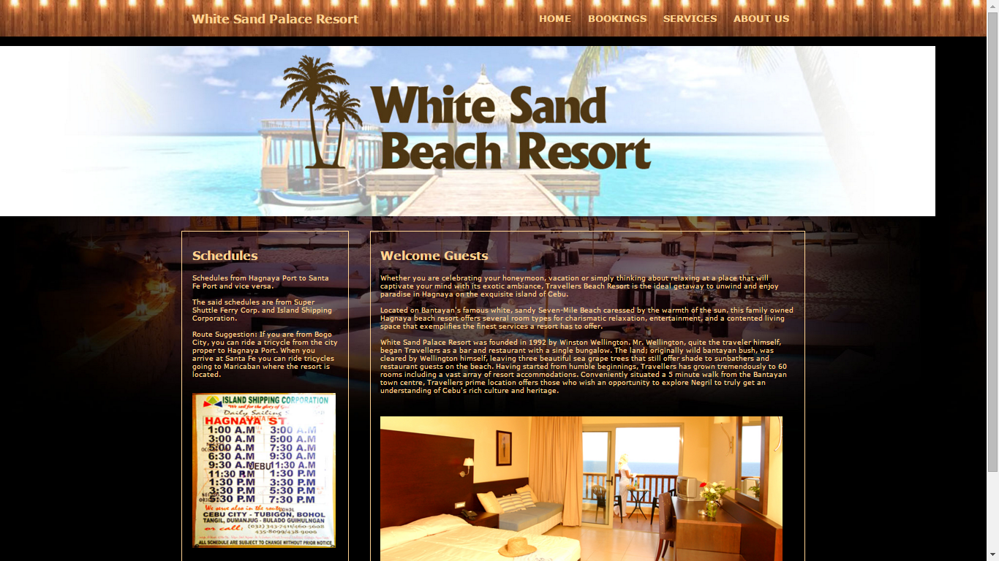
Website Page Layout
Homepage (Index) F:\ \Comp. Final htmls\The Website(Final)\Index.html

Slide 11
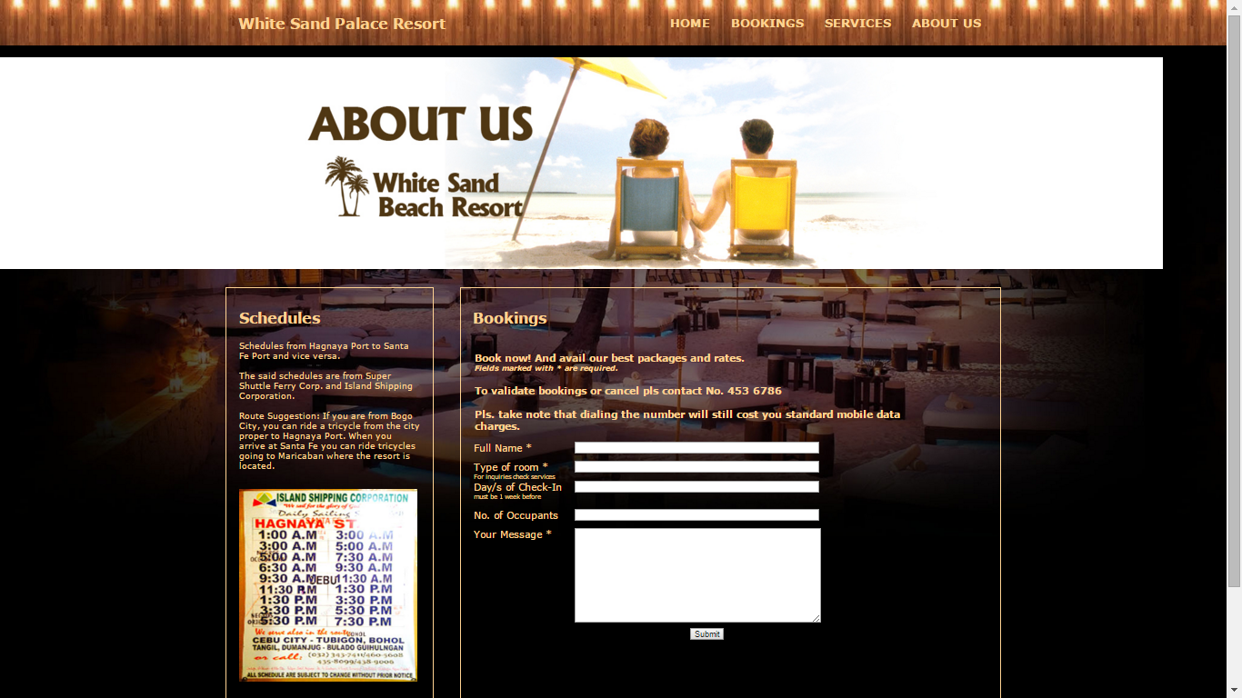
Website Page layout
Bookings F:\ \Comp. Final htmls\The Website(Final)\booking.html

Slide 12
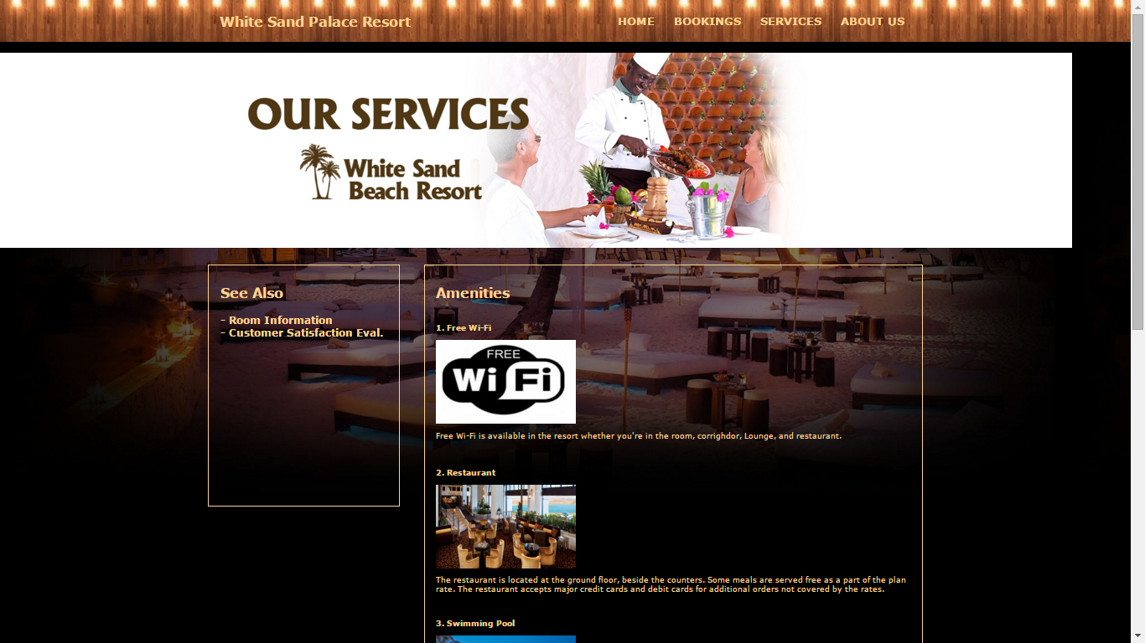
Website Page Layout
Services-Amenities F:\ \Comp. Final htmls\The Website(Final)\services.html

Slide 13
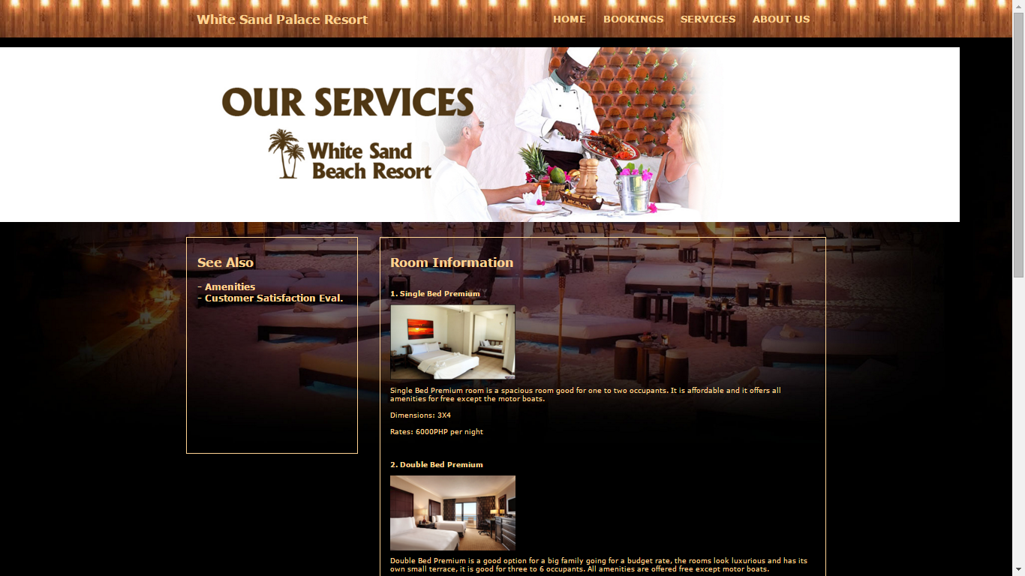
Website Page Layout
Room Information F:\ \Comp. Final htmls\The Website(Final)\RoomInfo.html

Slide 14
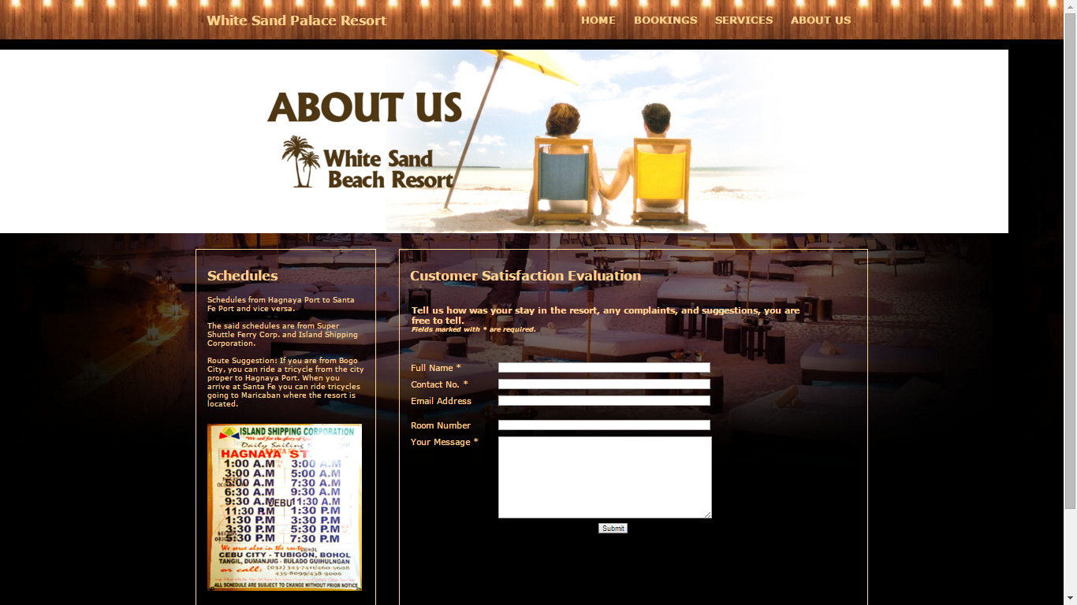
Website page Layout
Customer Satisfaction Evaluation F:\ \Comp. Final htmls\The Website(Final)\customer.html

Slide 15
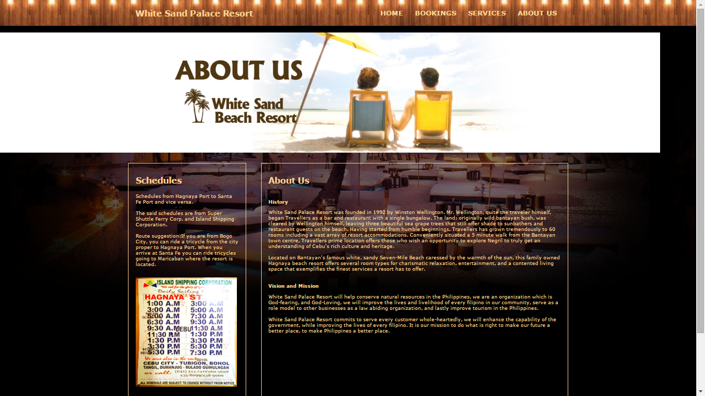
Website page layout
About Us F:\ \Comp. Final htmls\Aboutus.html

Slide 16
Conclusion
We the proponents conclude that the website is useful not just to the resort but to the travel industry and tourism of Bantayan.
We also conclude that our customers enjoyed using the website.
We conclude that using the website offers convenience on both sides.
We also conclude that the route suggestions we offer in the website is effective to travelers.
We conclude the website plays a vital role to the community.
We conclude that most of our customers stay a night in our resort to book a trip to Daan Bantayan.
Lastly we conclude that in order for the resort to be successful for years to come, adapting to such changes and entertaining every customer is important.

Slide 17
Recommendation
We the proponents highly recommend this project to tourists.
We also recommend the website, the resort as a whole to everyone who wants a luxurious yet affordable stay around Bantayan Island.
We also recommend the website to everybody interested to explore Bantayan.
For vacationers who are fond of surfing the net we recommend the website.
We recommend the website to those who have a hectic time schedule.
The website is also recommended to families wanting to have a vacation together.
Lastly we best recommend the website to those newlyweds planning to have their honeymoon away from the urban places

